Slide 1
Finalgo Strategy
PUNEET SINGH
Roll No 2100291530043

Slide 2
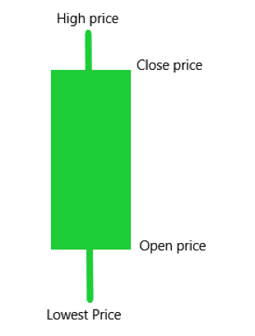
How chart price works?
(25)
(20)
(10)
(5)

Slide 3
WHAT IS MOVING AVERAGE?
A moving average (MA) is a technical indicator that smooths out price data by calculating the average price of a security over a specific period of time. It's a tool that traders use to identify trends, potential support and resistance levels, and generate buy and sell signals.
Calculation:
The SMA is calculated by adding all the data for a specific time period and dividing the total by the number of days. The EMA assigns greater weight to the most recent data

Slide 4
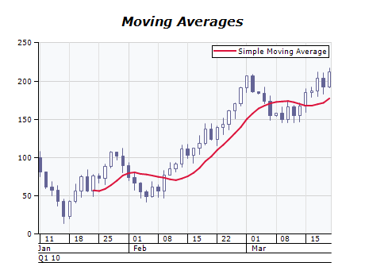
Moving Average EXAMPLE

Slide 5
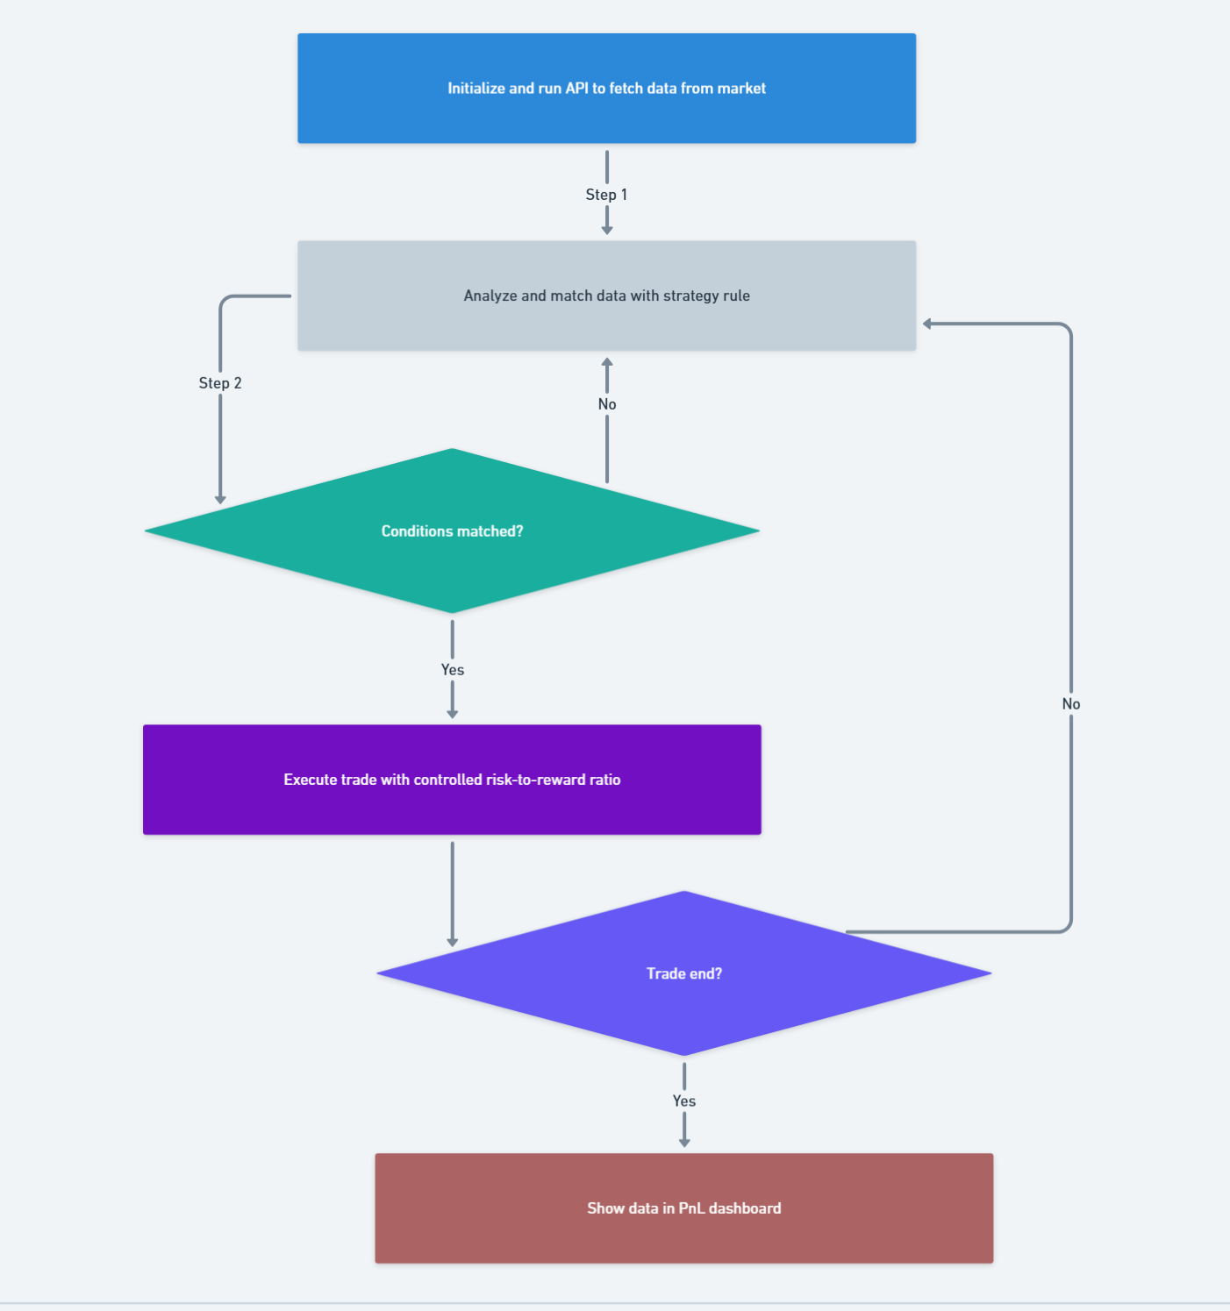
WORK FLOW

Slide 6
THANK YOU

